Slide 1
Journey Map
Aum Rajadnye
Associate Data Engineer

Slide 2


Journey Map
Case Work
Aum Rajadnye
Associate Data Engineer

Slide 3
Key Learnings (28/08/23)
Carried out a case study that involving implementing a complete CI/CD workflow for a SpringBoot application
Used Azure DevOps, GitHub, GitHub Actions, Maven, Docker, Azure WebApp, Azure VM, Prometheus

Slide 4
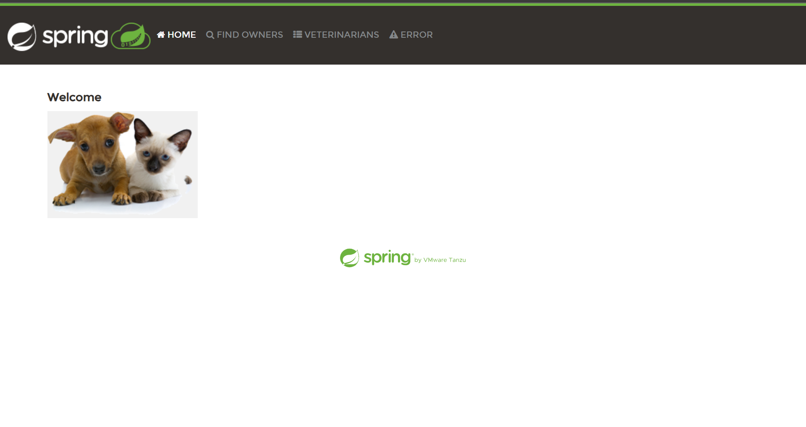
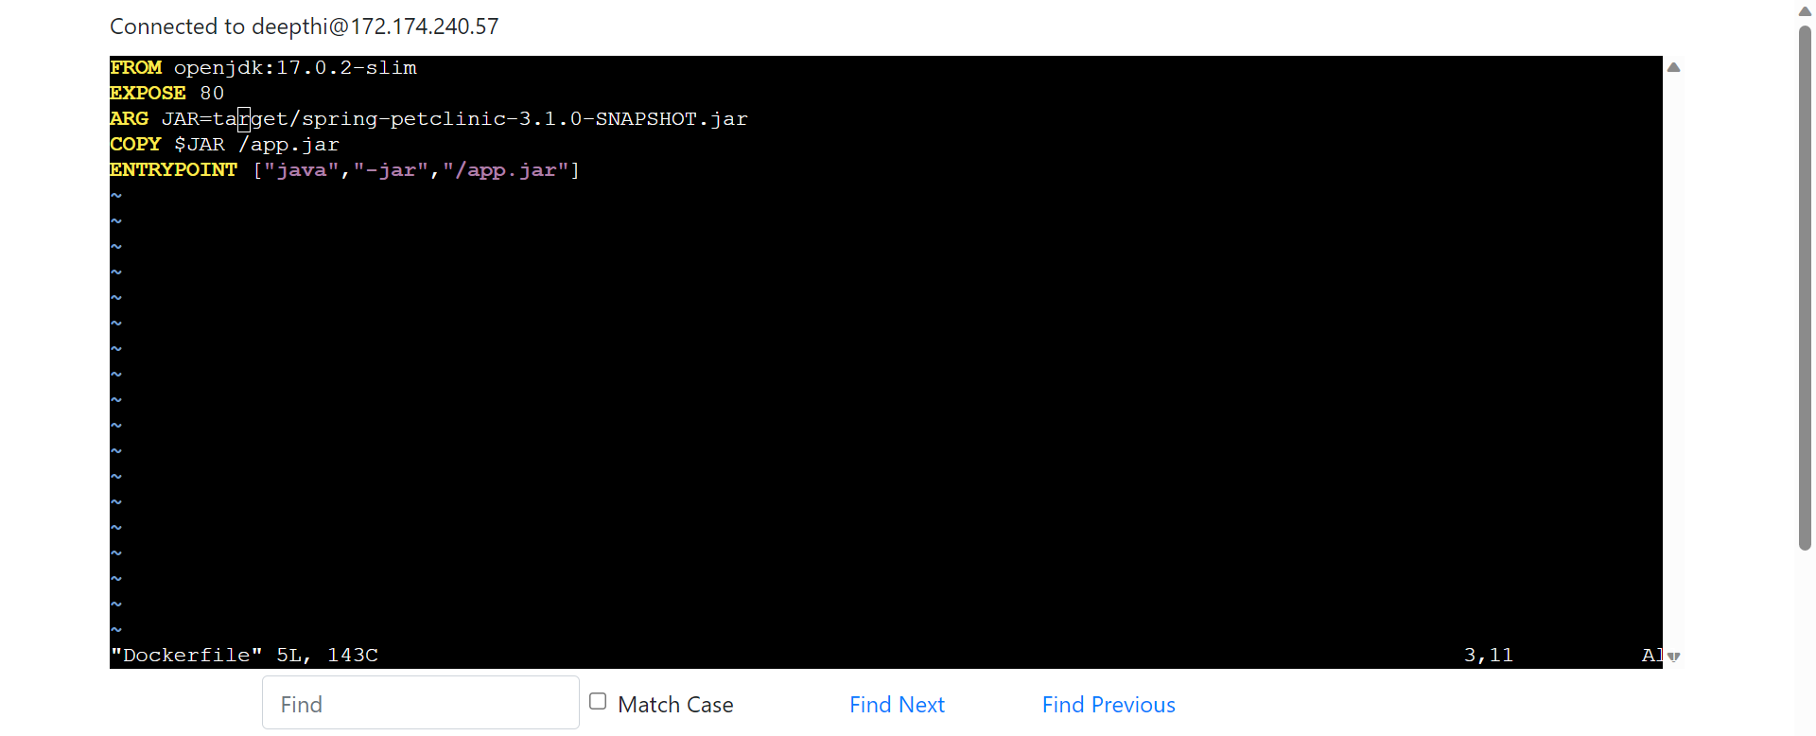

Slide 5

Journey Map
Custom Training
Aum Rajadnye
Associate Data Engineer

Slide 6
Business Intelligence (29/08/23)
Introduction to analytics and its importance
Introduction to Data Warehouse
RDBMS
Normalization
Joins
Cardinality
Dimension Modeling
Data Mining

Slide 7
Data Warehouse and Data Lakes (30/08/23)
Data Warehouse - relational database that is designed for query and analysis rather than transaction processing.
Data Lakes - a system or repository that stores large amounts of data in its natural form
Star, Galaxy and Snowflake schemas
Sorting, filtering in SQL
OLAP and OLTP - two types of online processing systems that help turn data into information
OLTP is optimized for executing online database transactions
OLAP is optimized for conducting complex data analysis

Slide 8
Aggregation (31/08/23)
Hands-On on Azure SQL Database
Executed Queries on Northwind Database
SQL Aggregation statements:
MIN
MAX
SUM
AVG

Slide 9
Azure SQL (01/09/23)
Inner Join, Outer Join
Correlated nested queries
Chasm and Fan Traps
UNION, INTERSECTION
Indexing types
Clustered
Non clustered

